Slide 1





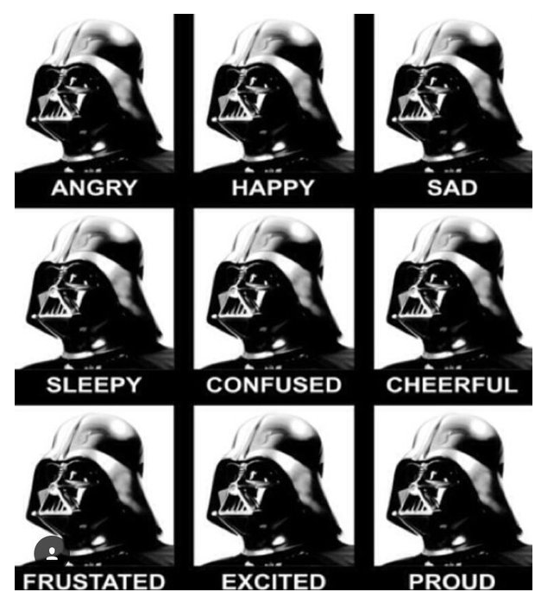


HTML
CSS
JAVASCRIPT
LEAFLET
Can a trail’s popularity be predicted by its features?

Slide 2
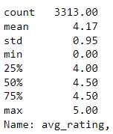
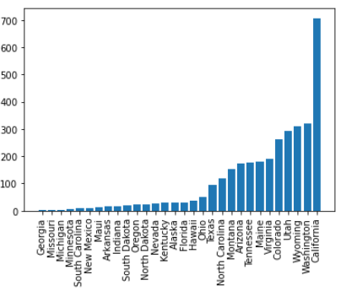
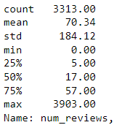
AVERAGE RATING
The average ratings are very tightly distributed. Difficult to distinguish excellent vs good trails.
Number of Trails per State
NUMBER OF REVIEWS
Trail popularity, based on the number of reviews, shows variation.
What’s driving a trail’s popularity?

Slide 3
